Slide 1
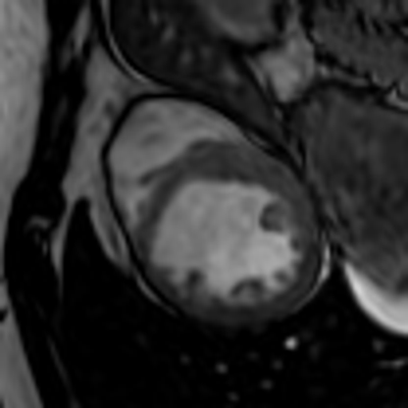
Neural Fields for Continuous Cardiac Cine‑MRI
BEIHANG UNIVERSITY · GROUP 4 · FINAL PROJECT
One heartbeat stored as one function f(x, y, z, t): it can be asked about any point and any moment, including places the scanner never measured.
Bezborodnikov Danil LS2625207 · Nikolai Kuzmichenko LS2657208
Yi Du ZY2657129 · Qingyun Yan ZY2657323
Jianxiang Liu ZY2657411
Drawn by our network: 60 moments of one heartbeat from a 30‑frame scan (ACDC patient 051).
Course instructor: Aqil Tariq · Final presentation, 2 November 2026
Notes:
Good morning. We are Group 4, and our project is Neural Fields for Continuous Cardiac Cine-MRI. The beating heart on the right is not the scan. It is drawn by our trained network: 60 moments of one heartbeat, although the scanner recorded only 30. Today we show how we store a whole heartbeat as one function, how we tested it, and what came out of it.

Slide 2
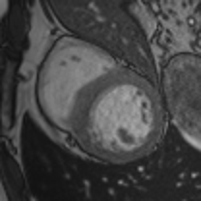
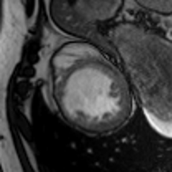
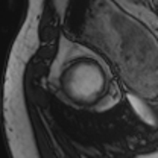

A cine‑MRI scan is a grid with gaps
THE PROBLEM
10 mm
between slices, while pixels inside a slice are 1.6 mm: nothing is stored in between.
Three of the 10 short‑axis slices (patient 051).
30 frames
per heartbeat: the motion between two frames is lost.
17.2 M
numbers for one heartbeat (224 × 256 × 10 slices × 30 frames).
A cut across the slices: the heart as 10 blocks.
Group 4 · Neural Fields for Continuous Cardiac Cine‑MRI
2
Notes:
A cardiac MRI scan is stored as a grid. Inside a slice, one pixel is 1.6 millimetres, but the slices are 10 millimetres apart, so between them nothing is stored. One heartbeat has only 30 frames, so the motion between frames is lost. And one heartbeat takes 17 million numbers. In the cut across the slices, the heart looks like ten blocks. The real heart is smooth. Our question: can we store it as something continuous?

Slide 3

Store the heart as a function, not as a grid
THE IDEA
INPUT
SIREN NETWORK
OUTPUT
(x, y, z, t)
sin(30 · (Wx + b))
intensity
a position in millimetres and a moment of the heartbeat
4 layers × 256 sine neurons, 198,913 weights
the image brightness at exactly that point
Train once per patient
Then ask anywhere
Why sines
on the measured voxels only; about 25 minutes on a laptop CPU.
between slices, between frames, on any grid we choose.
a ReLU network blurs fine detail; SIREN keeps it (Sitzmann et al., 2020).
Group 4 · Neural Fields for Continuous Cardiac Cine‑MRI
3
Notes:
Our idea: store the heart as a function, not as a grid. A small network takes four numbers, the position x, y, z in millimetres and the moment t, and returns the brightness at that point. It is a SIREN: every neuron computes a sine. Four layers of 256 neurons, about 199 thousand weights. We train it once per patient, about 25 minutes on a laptop, and then we can ask it anywhere: between slices and between frames. We use sines because a normal ReLU network blurs fine detail.

Slide 4
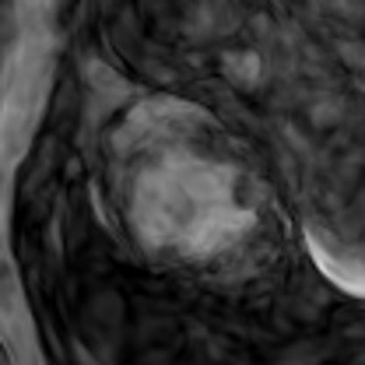
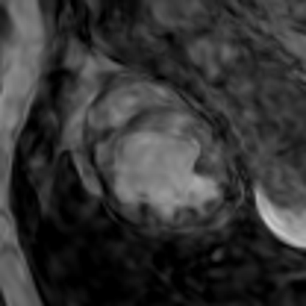
Slow the sines down along time and across slices
OUR CONTRIBUTION
Time enters as t × 0.1
Slice position enters as z × 0.25
Hidden frames, PSNR in the heart (dB)
A hidden slice, 10 mm from each known neighbour
raw t
22.7
sin / cos
28.9
scaled t
29.3
+6.6 dB only from how time enters. Scale sweep with every 4th frame kept: 0.25 → 28.2, 0.1 → 28.9, 0.05 → 28.8 dB.
raw z: noise
z × 0.25: smooth
19.95 → 20.09 dB in the heart (interpolation 20.01).
Why: with sin(30 · …) the network can swing between the frames or slices it saw. Scaling one input slows the sines along that axis only.
Group 4 · Neural Fields for Continuous Cardiac Cine‑MRI
4
Notes:
The plain SIREN was not enough. Our own contribution is two simple changes. Left, time: with raw t the network learns the frames it saw and swings between them, only 22.7 dB on hidden frames. If we multiply t by a small number inside the model, we get 29.3 dB, plus 6.6 dB. The best value was 0.1. Right, the same problem across slices: with raw z the hidden slice is full of noise; z times 0.25 makes it smooth. Scaling one input slows the sines along that direction only.

Slide 5

Real patients, one command from scan to 3D heart
DATA AND PIPELINE
ACDC patient 051 · main patient
Patient 015 · second check
Public cine‑MRI with expert labels (MICCAI 2017). Previous myocardial infarction. 224 × 256 pixels of 1.64 mm, 10 slices 10 mm apart, 30 frames. Labels of both ventricles and the muscle at end‑diastole and end‑systole.
Dilated cardiomyopathy, 9 slices, 21 frames. Used to repeat the hidden‑slice test on a different heart.
Load
Normalise
Train
Query
Evaluate, 3D
4D NIfTI scan
mm coordinates
20,000 Adam steps
any grid, any time
PSNR, SSIM, meshes
setup.bat → python scripts/pipeline.py --patient data/acdc/patient051
Group 4 · Neural Fields for Continuous Cardiac Cine‑MRI
5
Notes:
Our data is real: the public ACDC dataset from the MICCAI 2017 challenge, with labels from experts. Our main patient, 051, had a heart attack: 10 slices, 30 frames, and labels of both ventricles at two moments. Patient 015, with a different disease, is our second check. The pipeline has five steps: load the scan, turn voxels into coordinates in millimetres, train, ask the network on any grid, then evaluate and build the 3D heart. One setup file installs everything, and one command runs the whole study.

Slide 6
Hide part of the scan, then ask the network for it
HOW WE TEST
Example: only every 4th frame is shown to the network (9 of 30 kept, 21 hidden)
frame 0 · shown
dashed = hidden, scored
frame 29
What we hide
What we compare
What we score
Frames: every 2nd hidden, or only every 4th kept. Slices: every 2nd hidden (a 20 mm gap).
Linear interpolation from the same known data, and a ReLU network with the same 198,913 weights.
PSNR inside the heart (expert labels), plus SSIM. Only on hidden data. +10 dB = 10× smaller error.
Group 4 · Neural Fields for Continuous Cardiac Cine‑MRI
6
Notes:
To test honestly, we hide part of the scan and ask the network for it. Here the network sees only every fourth frame, the dark ones; the 21 dashed frames are hidden and scored. We also hide every second frame, or every second slice. We compare with linear interpolation between the known neighbours, and with a ReLU network of the same size. We score only hidden data, with PSNR inside the heart. Plus 10 dB means ten times smaller error.

Slide 7
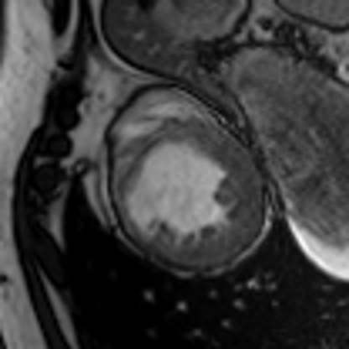
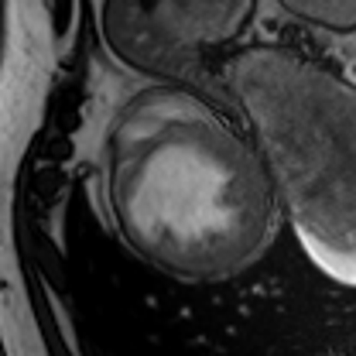


SIREN beats a ReLU network of the same size
RESULT 1
Truth (hidden)
Interpolation 25.7 dB
SIREN 26.5 dB
ReLU 21.8 dB
Hidden frame 6 of 30 (only every 4th frame shown), mid‑ventricle slice. dB = PSNR in the heart for this frame.
28.9 vs 22.3 dB over all 21 hidden
frames, same 198,913 weights,
same training.
24.5 dB
ReLU on the frames it saw (SIREN: 36.5).
It cannot learn fine detail at all.
+6.6 dB
Group 4 · Neural Fields for Continuous Cardiac Cine‑MRI
7
Notes:
Result one. This is frame 6, which the network never saw. Interpolation gives 25.7 dB, SIREN 26.5, and the ReLU network only a blurry shape, 21.8. Over all 21 hidden frames SIREN is 6.6 dB better than ReLU, with the same number of weights. ReLU reaches only 24.5 dB even on the frames it trained on. This is why we use sines.

Slide 8
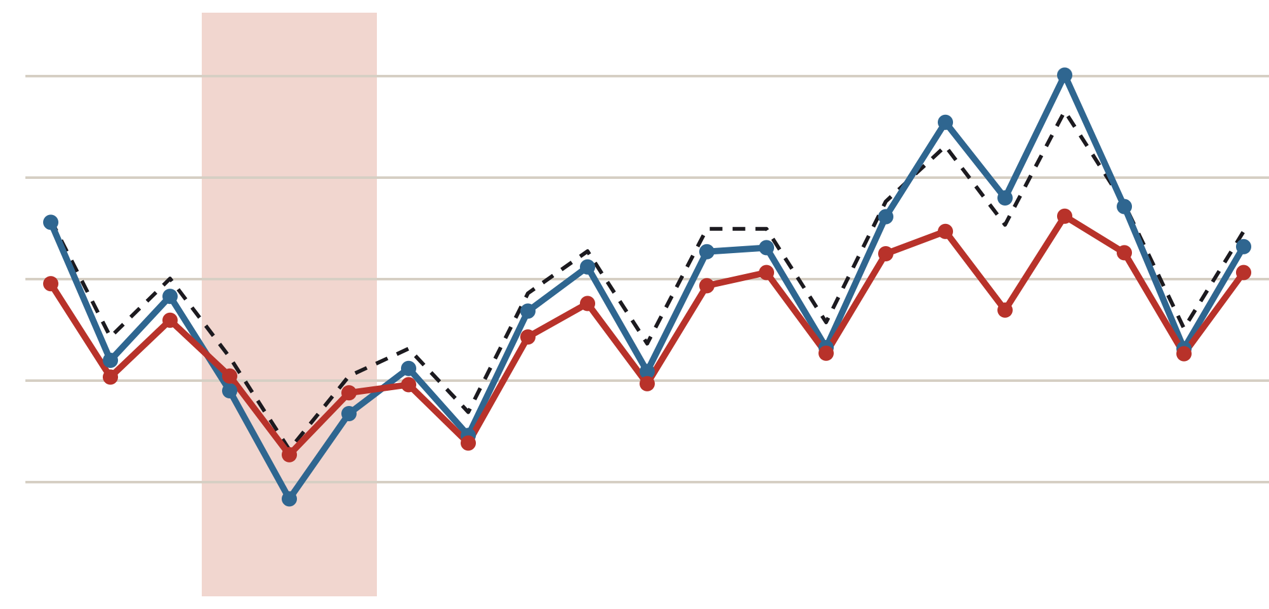
Against interpolation: close, and ahead where the heart moves fastest
RESULT 2
fast contraction
dB, heart | every 2nd hidden | every 4th kept
Interpolation | 33.1 | 29.2
SIREN | 31.3 | 28.9
Blend ½ + ½ | 32.9 | 29.7
34
32
30
28
26
SIREN wins frames 5–7, where a straight line between two frames misses the motion.
The blend wins 18 of 21 hidden frames. Its weight 0.5 was fixed before testing.
PSNR in the heart (dB) for each hidden frame 1 → 27; only every 4th frame shown
━ interpolation ━ SIREN ╍ blend ½ + ½
Group 4 · Neural Fields for Continuous Cardiac Cine‑MRI
8
Notes:
Result two, the strong baseline: interpolation. To be honest, on average it is still a little ahead: 29.2 against our 28.9 dB, a gap of 0.4 dB. But look at the shaded part: when the heart contracts fastest, a straight line between two frames misses the motion, and SIREN wins. The two methods make different mistakes, so we averaged them with a fixed weight of one half. This blend beats interpolation: 29.7 dB, better on 18 of 21 frames.

Slide 9
Compression has a price, and we measured it
RESULT 3
SIREN · HEART REGION
SIREN · WHOLE SCAN
INTERPOLATION
16×
86×
1×
fewer numbers than the voxels it replaces (8× smaller file)
fewer numbers, the target from our midterm (43× smaller file)
keeps every stored frame; no compression at all
28.9 dB
27.5 dB
29.2 dB
The same 198,913 weights: stretched over the whole scan they lose 1.4 dB in the heart.
A 4× larger network (512 neurons) gave the same 28.9 dB: size is not the bottleneck.
Group 4 · dB = PSNR in the heart on hidden frames, every 4th frame kept
9
Notes:
Result three: compression. At the midterm we promised about 86 times fewer numbers. The same network can store only the heart region, 16 times fewer numbers, at 28.9 dB, or the whole scan, 86 times fewer, at 27.5 dB. Interpolation compresses nothing. A four times bigger network did not help, so size is not our limit.

Slide 10
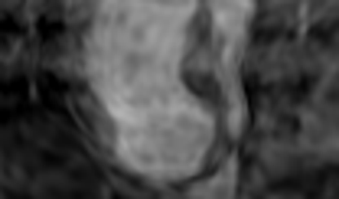
Between slices: a smooth heart instead of 10 mm blocks
RESULT 4
Scanner: 10 slices × 10 mm
Test: every 2nd slice hidden (20 mm gap)
dB, heart, patient 051 | hidden slices
Interpolation | 20.01
SIREN, raw z | 19.95
SIREN, z × 0.25 | 20.09
ReLU | 18.83
Neural field: 61 slices × 1.6 mm
Patient 015 confirms the picture: 20.4 vs 20.7 dB in the heart, 20.8 vs 20.1 on the crop.
A 20 mm gap is a limit of the data: the heart changes shape over that distance. SIREN is level with interpolation and adds no artefacts.
Group 4 · Neural Fields for Continuous Cardiac Cine‑MRI
10
Notes:
Between slices. The scanner gives ten blocks; our network, asked every 1.6 millimetres, gives a smooth heart from base to tip. When we hid every second slice, a 20 millimetre gap, no method could really fill it: all are near 20 dB. With scaled z, SIREN is level with interpolation and has no noise, and the second patient shows the same.

Slide 11
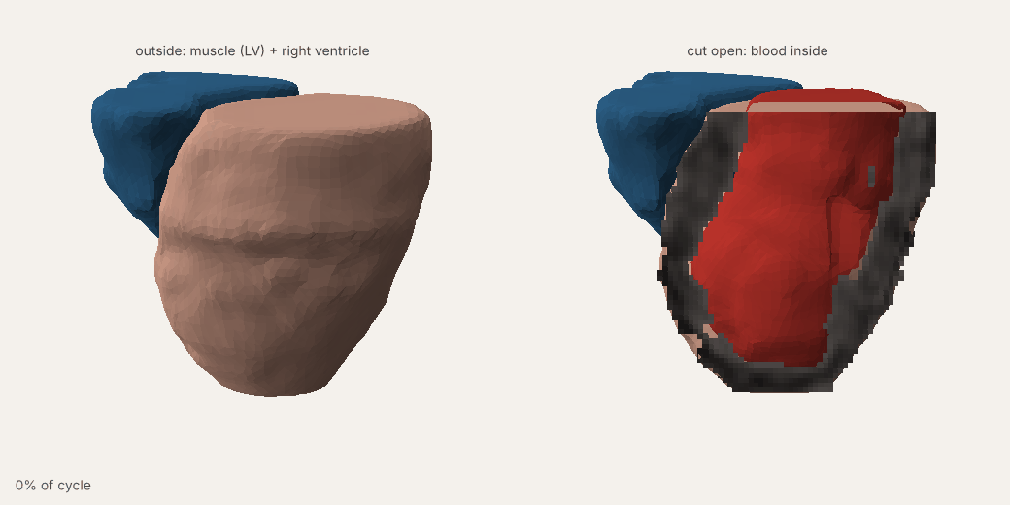
A beating 3D heart, queried from one network
RESULT 5 · DEMO
61 × 1.6 mm
slices asked from the network (the scanner has 10 × 10 mm)
30 moments
of one heartbeat, any number possible
0.8 MB
one file of weights holds the whole beating heart
Live demo: results/patient051/final/heart4d/heart_4d.html — rotate, cut open, pause at any moment.
Group 4 · Neural Fields for Continuous Cardiac Cine‑MRI · marching cubes on the field, Taubin smoothing
11
Notes:
This is our main result: one network trained on all frames, asked on a grid six times finer than the scanner. We build surfaces where the brightness changes from blood to muscle. On the left, the heart from outside; on the right, cut open: the cut shows the network's own image of the wall, and the red blood inside contracts. Now a short live demo. [open heart_4d.html: rotate, untick the muscle, drag the slider — 20 seconds]

Slide 12
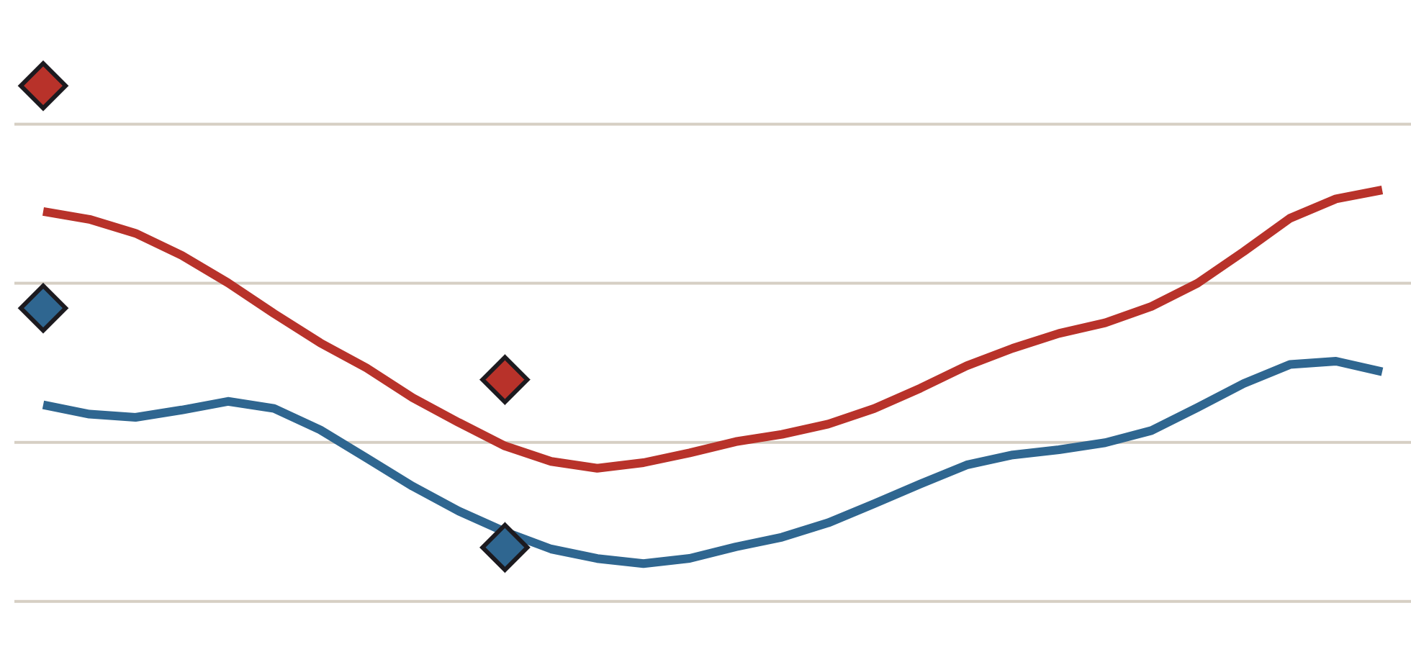
The 4D heart pumps like the real one
RESULT 6 · CLINICAL CHECK
Ejection fraction
200
source | LV | RV
Expert labels | 44% | 53%
Our method on scanner | 47% | 53%
Neural field | 49% | 51%
left ventricle
150
100
right ventricle
Our blood threshold leaves the papillary muscles out, so volumes are lower than the experts’ (LV 179 vs 212 ml). The ejection fraction is a ratio and stays close.
50
Blood volume (ml) over one heartbeat, 30 moments, from the neural field. ◆ = expert labels.
Group 4 · Neural Fields for Continuous Cardiac Cine‑MRI · EF = (largest − smallest volume) / largest
12
Notes:
Is it correct? Doctors judge a heart by its ejection fraction. From our 4D model we get 49 percent for the left ventricle, experts 44; and 51 for the right, experts 53. Volumes are a bit lower, because our threshold leaves out the small muscles inside the ventricle.

Slide 13





What we showed, and what we did not
CONCLUSIONS
Sines matter: SIREN is 6.6 dB better than a ReLU network of the same size.
Limits
How time and slice position enter matters: scaling t and z is our own contribution.
One main patient and one check patient.
A 20 mm slice gap is beyond any method.
On average interpolation is still 0.4 dB ahead.
About 25 minutes of CPU training per patient.
Level with interpolation, ahead in fast contraction; the blend beats it (29.7 vs 29.2 dB).
One network holds the heartbeat with 16× to 86× fewer numbers.
A continuous 4D heart whose ejection fraction is within 5 points of the experts.
Thank you. Questions?
github.com/ultralightbeat/cardiac-inr
Group 4 · Neural Fields for Continuous Cardiac Cine‑MRI
13
Notes:
To sum up: sines matter, plus 6.6 dB; scaling time and slice position is our own contribution; we are level with interpolation, and the blend beats it; and from one network we get a 4D heart that agrees with the experts. Our limits: two patients, and interpolation is still slightly ahead on average. Thank you, we are happy to answer your questions.

